Slide 1
FRUITFUL LAND OF
MOAB

Slide 2
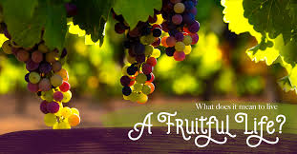
FRUITFUL LAND OF MOAB Jeremiah 48:33 Gladness and joy have been taken away from the FRUITFUL LAND of Moab; I have made the wine cease from the winepresses; no one treads them with shouts of joy; the shouting is not the shout of joy.”

Slide 3
LOOKS FRUITFUL &
BEAUTIFUL BUT
NOT FRUITFUL
OR USEFUL

Slide 4
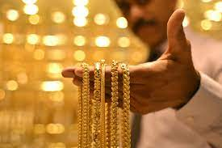
All that glitters
is not gold

Slide 5
PRIDE & SELF RELIANCE RATHER THAN SURRENDER AND DEPENDENCE ON GOD WAS THE CAUSE OF DOWNFALL OF MOAB

Slide 6
PROSPERITY IS GIVEN MORE VALUE THAN ETERNITY

Slide 7
^{Jeremiah 48:30} I know her insolence but it is futile,” declares the Lord, “and her boasts accomplish nothing.

Slide 8
Luke 12:20 “You fool! This very night your life will be demanded from you. Then who will get what you have prepared for yourself?

